Slide 1
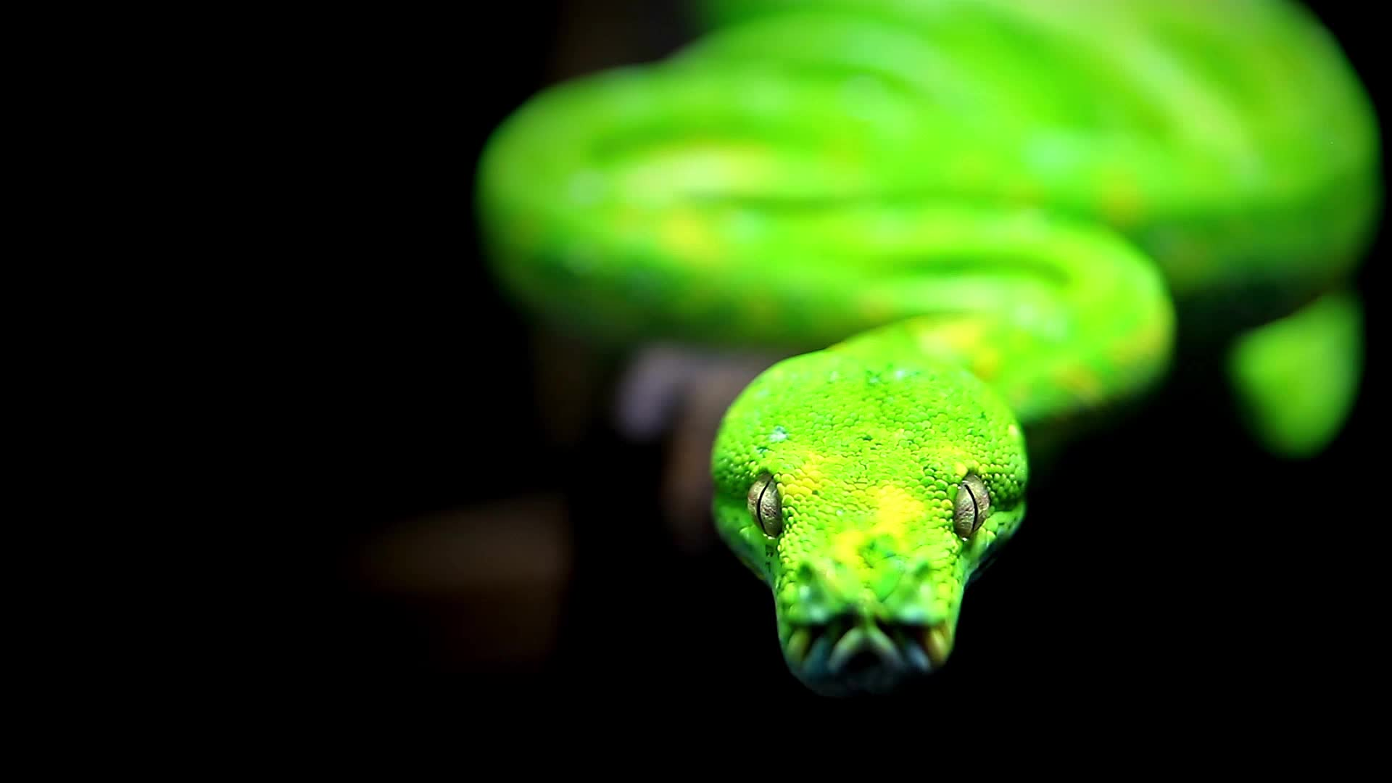
Practical use of decorators in Python
Introduced by: Krzysztof Stefański Mateusz Setkowicz

Slide 2

Functions are first class objects
Can be passed as arguments to other functions
Can be returned as values from other functions
Can be assigned to variables
Can be stored in data structures such as lists or dictionaries
Can be defined inside other functions
Can be passed as arguments to other functions
Can be returned as values from other functions
Can be assigned to variables
Can be stored in data structures such as lists or dictionaries
Can be defined inside other functions

Slide 3
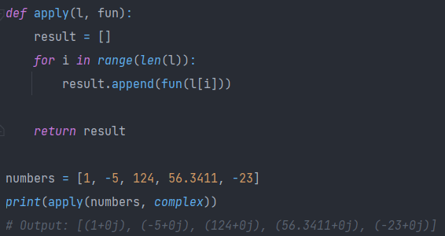
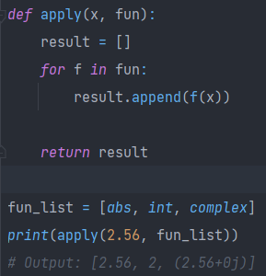
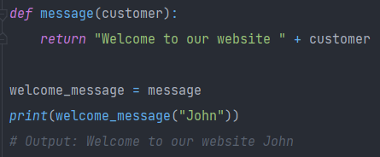
Function passed as an argument
Function as element of a list
Function assigned to a variable

Slide 4

Can be defined inside other functions - nested functions, closures

Slide 5
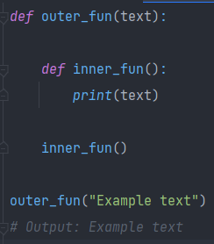

Nested functions with examples

Slide 6
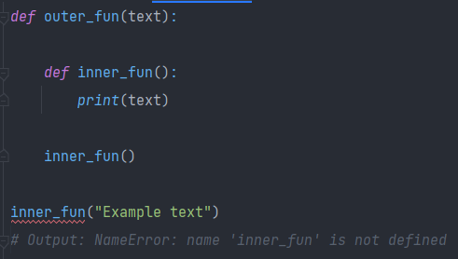

What cannot be done?

Slide 7


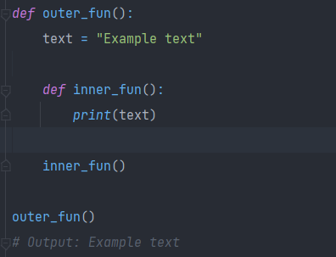
Scope of variables in nested functions

Slide 8
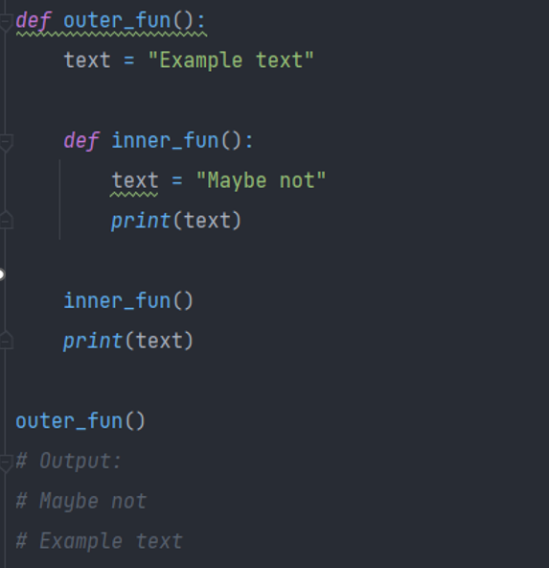
Quick reminder
Python assumes that text is a local variable in inner_fun and it creates a new variable with the same name. As a result, variable text in an enclosing scope is not modified.

Slide 9
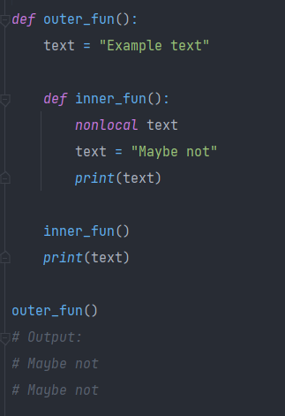
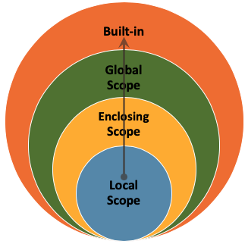
Nonlocal keyword

Slide 10

Closures
A function that captures the state of its environment when its created.

Slide 11
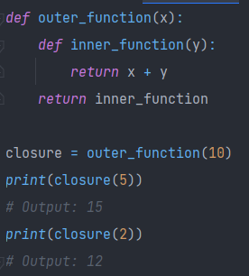

When the outer_function is called it returns a reference to the inner_function
The inner_function has access to the value x even after outer_function has completed execution
The returned inner_function can be called with multiple y values while still retaining the value of x

Slide 12

Decorators
Decarator is essentaily a closure that takes a function as its argument and returns a new function that modifies the bahaviour of the original function.
Decarator is essentaily a closure that takes a function as its argument and returns a new function that modifies the bahaviour of the original function.

Slide 13
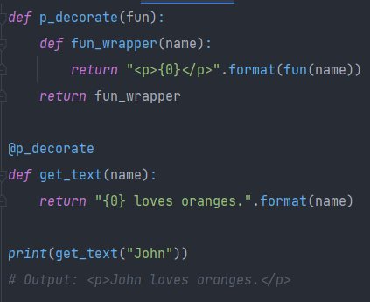

Our first decorator
Syntax „@” basically does this
Syntax @ makes our decorator p_decorate automatically take get_text function as an argument and process it.

Slide 14
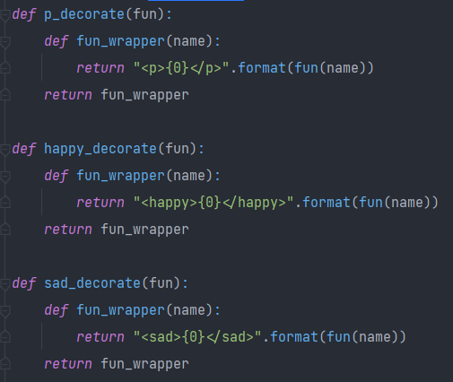
Using multiple decorators
Creating more similar decorators

Slide 15
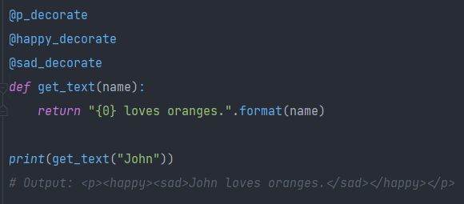
Another approach?
Using multiple decorators

Slide 16
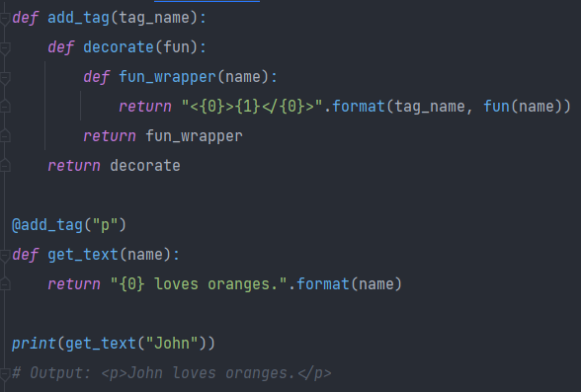
Decorator parametrization

Slide 17

Examples of builtin decorators and other useful tools

Slide 18
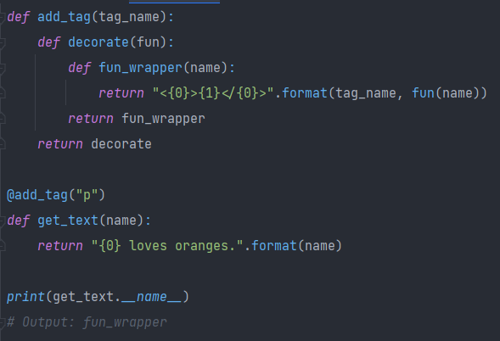
Decorators do not carry the name of the function, so debugging can be problematic. Fortunately, since Python 2.5 there is a solution to this issue.

Slide 19
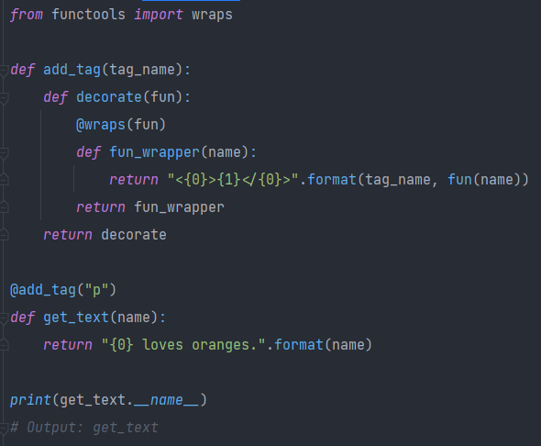
The module contains functools.wraps which solves the issue mentioned earlier. It decorates fun_wrapper and updates its attributes to those of an original function.
Functools
module
@wraps

Slide 20
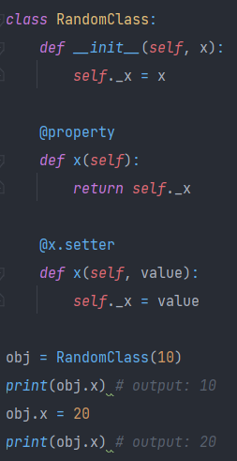
Can be considered a pythonic way of defining setters and getters. Obj.x automatically calls setter or getter.
@Property
Works as a getter
Works as a setter

Slide 21
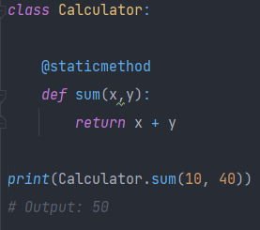
@staticmethod
Knows nothing about class state. Cannot access or modify it. Is bound to the class and not an object of the class.

Slide 22
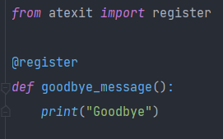
Atexit
@register
The register decorator names a function to be ran at termination. This would work whenever you need to save some data before program exit.

Slide 23
Other custom examples

Slide 24
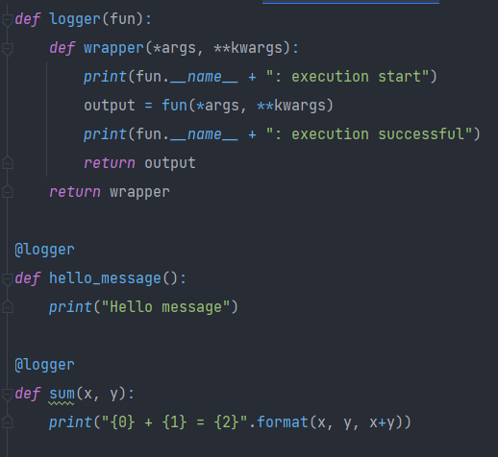

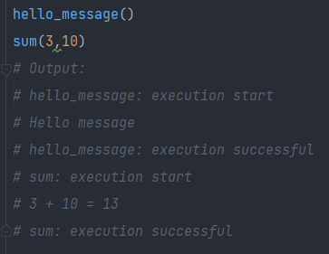
Logger

Slide 25
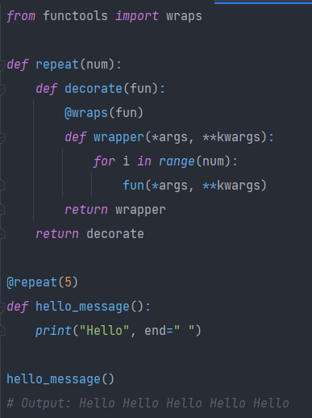

Repeater

Slide 26
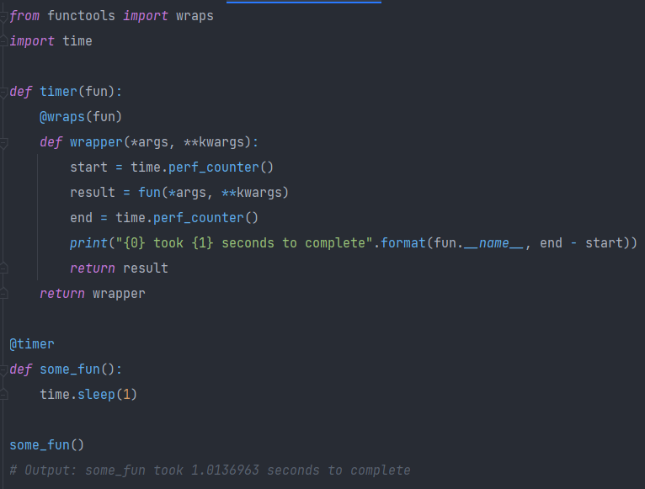

Timer

Slide 27

Summary

Slide 28

Where can decorators be used?
Timing: to time how long a function takes to run
Authorization: You might use it to check whether the user is authorised to access for example some data
Logging: To log information about function calls
Caching: You might cache some results of a function to speed up its usage
Validation: You can validate input parameters before calling a function
Testing and debugging: You can make a function rerun itself many Times and log its calls without deep interference into its code
Error handling: You can catch and handle errors more efficiently

Slide 29

Why to use tchem?
Modularity: You can keep your code modular and reusable
Readability: Decorators can make your code more readable and easier to understand
Flexibility: You can modify the behaviour of existing code without deep interference
Maintability: Using decorators might make your code more maintainable
Customization: You can quite easily customize the behaviour of your code to your needs
DRY: Don’t repeat yourself, decorators help to reduce repetitions in code

Slide 30

Bibliography
https://www.python.org/dev/peps/pep-0318/
https://www.artima.com/weblogs/viewpost.jsp?thread=240845
http://thecodeship.com/patterns/guide-to-python-function-decorators/
https://wiki.python.org/moin/PythonDecoratorLibrary

